Slide 1
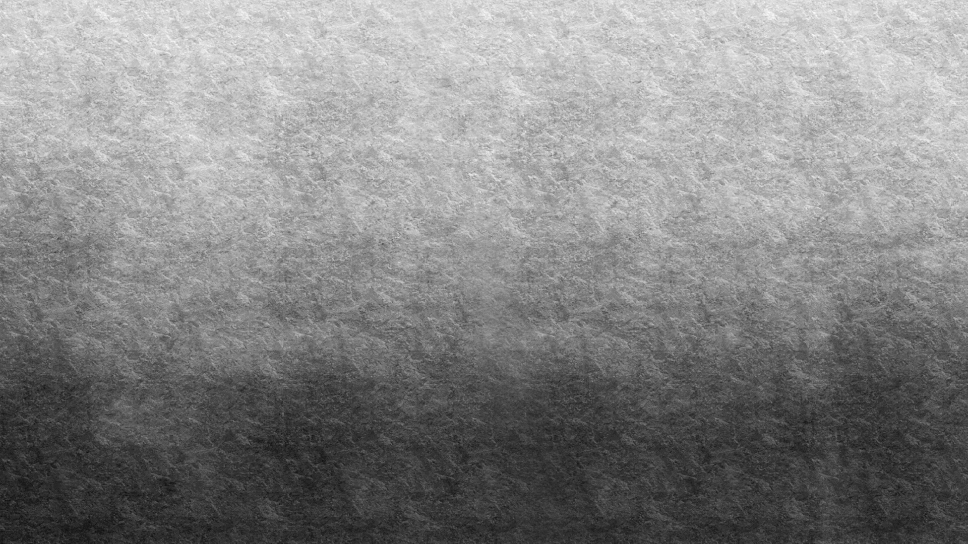

Low Fat Tortilla Chips

